Slide 1
Quadratic optimization with quantum computing
Presentation 2
Bálint Hantos
Supervisor: Péter Rakyta
Notes:
What I’m going to talk about today is that I iterate myself on the theoretical background of the project and amend it with some additional information.
Then I’m going to talk about how we installed the Piquasso Boost library on my computer with the help of my supervisor.
Then about some of the first steps I’ve taken trying out this library.

Slide 2
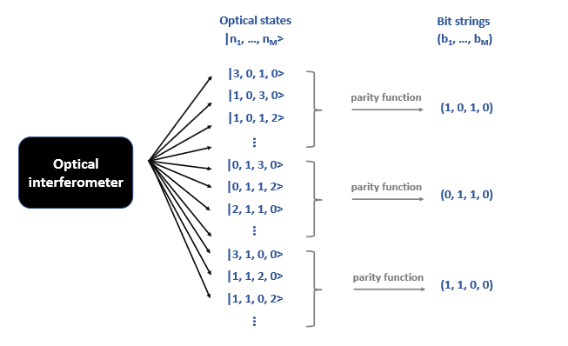
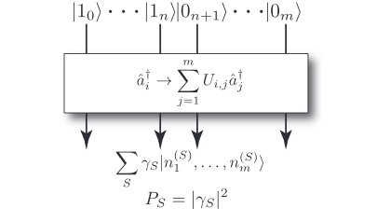


Overview: Boson sampling and parity mapping
$$α_{S}$$
$$\left|n\right\rangle →{|α|}^{2}$$
$$\left|n^{′}\right\rangle →{{|α}^{′}|}^{2}$$
$$α_{S}$$
$$β=α^{2}+α^{′2}$$
Gard, Bryan T., et al. "An introduction to boson-sampling.„ 2016
Bradler, Kamil, and Hugo Wallner., "Certain properties and applications of shallow bosonic circuits.„, 2021
Notes:
I just wanted to recap on what we’re doing and add some more info, which didn’t fit in the last meeting’s time.
So, on the left we have the diagram of the boson sampling model.
On top, there are single photon states and vacuum states, that are propagated through a linear optics network.
It implements a unitary map on the creation operators like this.
Then at the output we’ve got some superpositions of multiphoton optical states of all the configurations.
Then we measure the output and we get the one configuration with some probability.
Then this preparation of single photon states, the propagation through the interferometer and the measurement is repeated many times.
The goal is to build up a distribution of these output states.
That’s all about the figure on the left.
On the figure on the right we can see how the parity function operates:
There are optical states coming out of interferometer and we apply a modulo 2 operation on the Fock vectors’ elements.
Example
With this mapping there are multiple multiple optical states associated with one bit string.
Example
Then the question is why do we need a quantum computer for that?
One of the key results is that measuring the probability of a given configuration is proportional to a permanent of the A matrix.
The A matrix is a unitary transformation describing the linear optics network and the output configuration.
It is a very hard problem to calculate complex-valued matrix permanents. So boson sampling is classically inefficient to simulate, we need a real quantum device to that.

Slide 3
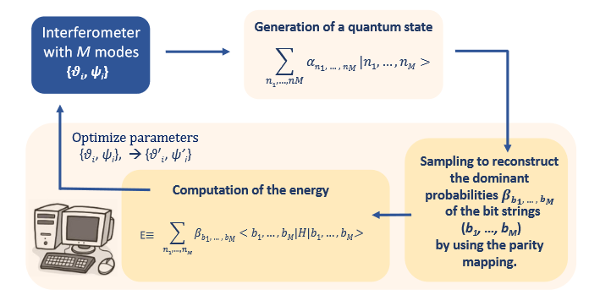
Model overview
Bradler, Kamil, and Hugo Wallner. "Certain properties and applications of shallow bosonic circuits.„ 2021
Notes:
With these in mind I think this graph makes more sense now.
This is the model overview of the variational bosonic solver.
In the first step we generate a quantum state with the M-mode interferometer.
The amplitudes of the quantum states depend on the circuit elements’ angles, thetas and psis.
Then we apply a parity function so that the we map the optical states to a many-qubit hilbert space. Then we have our qubits.
Note: Each qubit state has a some energy associated with it.
So we apply the parity functions and record the probabilities of the qubits.
Then using these probabilities and the qubit states we calculate the expected value of the energy – it is the objective function, that we try to minimize.
Then we tweak the psi and theta parameters with gradient descent and do the previous steps again.
The gradient descent is a little tricky, because it is not really feasible to generate enough samples to to see the difference between similar distributions.
For this step we need to do a trick called the parameter shift rule.
So we use the gradient descent with a trick.
The goal is to find the smallest energy and the associated bit string.
We need to formulate our our problem as optimizing the energy by choosing an appropriate Hamiltonian matrix.

Slide 4



Setup
Installed Ubuntu on Docker
Installed necessary dependencies
Compiled and built Piquasso Boost with Conda from Github source
Notes:
The piquasso boost library has a couple of dependencies, according to the readme most importantly the Piquasso library, then some other python libraries like scipy and numpy, quantum blackbird and strawberry fields.
For the building, we needed Cmake and scikit-build. The parallelism is handled with TBB and MPI libraries.
My supervisor helped me in the building and installing some of the dependencies.

Slide 5
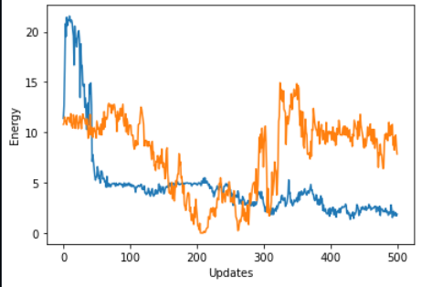
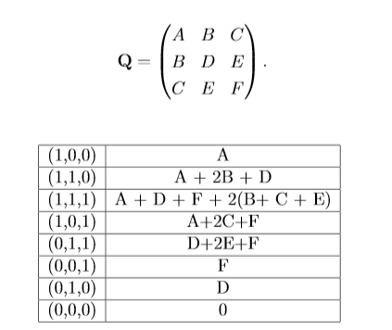
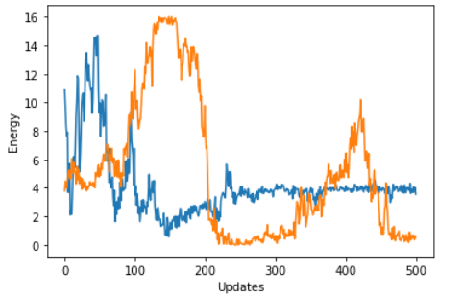
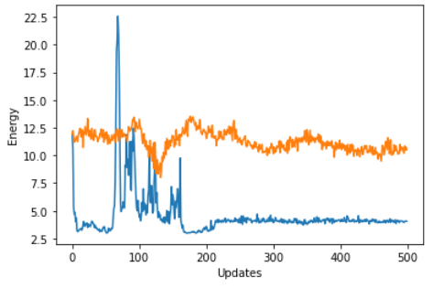
First steps
Degenerate case
General symmetric matrix
General case
Trivial case
Notes:
After that I checked how the variational QUBO-solver worked with some examples. I used a general 3-by-3 symmetric matrix to calculate its expected values with all possible binary vectors.
This is how the matrix looked like.
Under that we can see the expected value of the possible binary vectors.
In the middle we can see how the energy changes for a general Q symmetric matrix. There are two lines because we’re looking at both modulo classes for 2.
In corner cases for which the energy plots can be seen on the right, I found interesting things.
right on top Like when in the Degenerate case, when multiple binary vectors have the same minimal energy the algorithm returns the same vector deterministically.
right on bottom For the trivial case, when all matrix elements are positive numbers: this is where I found that with one of the parity maps the energy doesnt really decrease. But this might be in connection with the matrix elements.

Slide 6
Thank you for your attention
Notes:
Thank you for your attention.
Also I wanted to apologize, because I missed the deadline, so it

